Slide 1
Logistic Regression Modeling – Techniques from SAS Training
Carolyn Chen
October 2016

Slide 2
Exploring the Data
Macro variables:
Can be established to represent variables in order to reduce the amount of text that needs to be entered in subsequent programs.
MEANS procedure:
Can be used to generate descriptive statistics for the numeric variables. (missing values? binary values?)
FREQ procedure:
Can be used to examine the values of the target variable and the nominal input variables. (number of levels?)
Sample Code:
%global num_inputs cat_inputs;
%let num_inputs=ACCTAGE DDA DDABAL DEP DEPAMT CASHBK
CHECKS DIRDEP NSF NSFAMT PHONE TELLER
SAV SAVBAL ATM ATMAMT POS POSAMT CD
CDBAL IRA IRABAL LOC LOCBAL INV
INVBAL ILS ILSBAL MM MMBAL MMCRED MTG
MTGBAL CC CCBAL CCPURC SDB INCOME
HMOWN LORES HMVAL AGE CRSCORE MOVED
INAREA;
%let cat_inputs=ins branch res;
proc means data=work.develop n nmiss mean min max;
var &num_inputs;
run;
proc freq data=work.develop;
tables &cat_inputs;
run;

Slide 3
Exploring the Data
Preparing the Input Variables
Missing Values
Categorical Inputs
Variable Clustering
Variable Screening
Subset Selection

Slide 4
Exploring the Data
Preparing the Input Variables – 1. Missing Values
Indicators + Imputation
Create missing value indicator variables
Replace missing values with the variable median/mean. (predictive modeling)
Sample Code:
data work.train_mi(drop=i);
set work.train;
/* name the missing indicator variables */
array mi{*} MIAcctAg MIPhone MIPOS MIPOSAmt
MIInv MIInvBal MICC MICCBal
MICCPurc MIIncome MIHMOwn MILORes
MIHMVal MIAge MICRScor;
/* select variables with missing values */
array x{*} acctage phone pos posamt
inv invbal cc ccbal
ccpurc income hmown lores
hmval age crscore;
do i=1 to dim(mi);
mi{i}=(x{i}=.);
nummiss+mi{i};
end;
run;

Slide 5
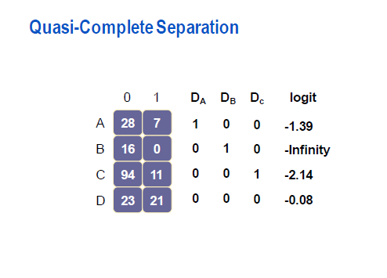
2. Preparing the Input Variables – Categorical Inputs
Exploring the Data
Preparing the Input Variables – 2. Categorical Variables
Problems with Categorical Inputs
When a categorical input has many levels, expanding the input into dummy variables can greatly increase the dimension of the input space.
Including categorical inputs in the model can cause quasi-complete separation.

Slide 6
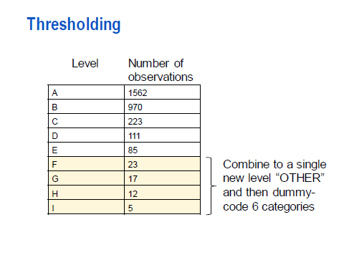
2. Preparing the Input Variables – Categorical Inputs
Preparing the Input Variables – 2. Categorical Variables
Dealing with Categorical Inputs
The best remedy for sparseness in the levels is to collapse the levels of a categorical input. Ideally, subject-matter considerations should be used to collapsing levels. This is not always practical in modeling.
Another strategy for dealing with categorical inputs with many levels is thresholding. This method requires a minimum number of cases in a level before creating a dummy code input (e.g., 50). Any level failing to meet this minimum threshold is relegated to a new level called OTHER. By reducing the number of inputs available to a model, thresholding limits the model’s ability to discover spurious input-target associations.

Slide 7
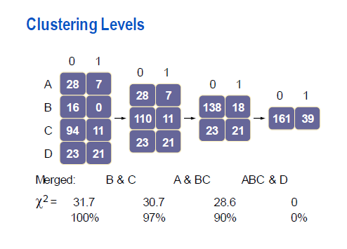
2. Preparing the Input Variables – Categorical Inputs
Preparing the Input Variables – 2. Categorical Variables
A Simple Data-driven Method for Collapsing Levels - Greenacre’s method (1988, 1993)
The levels (rows) are hierarchically clustered based on the reduction in the chi-squared test of association between the categorical variable and the target. At each step, the two levels that give the least reduction in the chi-squared statistic are merged. The process is continued until the reduction in chi-squared drops below some threshold (e.g., 99%). This method will quickly throw rare categories in with other categories that have similar marginal response rates. While this method is simple and effective, there is a potential loss of information because only univariate associations are considered.

Slide 8
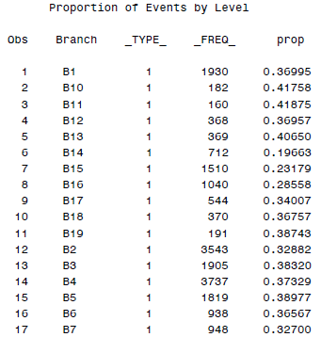
2. Preparing the Input Variables – Categorical Inputs
Preparing the Input Variables – 2. Categorical Variables
Greenacre’s method - Example
The variable Branch has 19 levels. The first step is to create a data set that contains the proportion of the target event (Ins) and number of cases in each level.
Sample Code:
proc means data=work.train_imputed noprint nway;
class branch;
var ins;
output out=work.level mean=prop;
run;
title1 "Proportion of Events by Level";
proc print data=work.level;
run;
Partial Output:

Slide 9
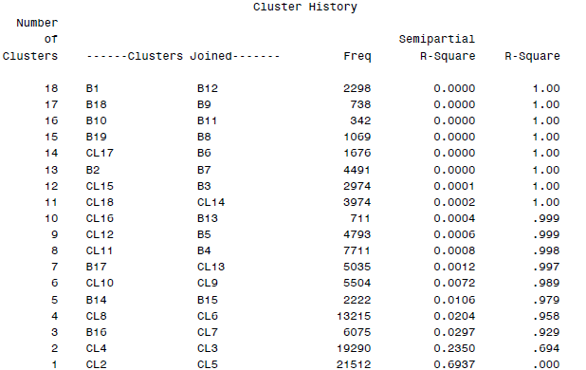
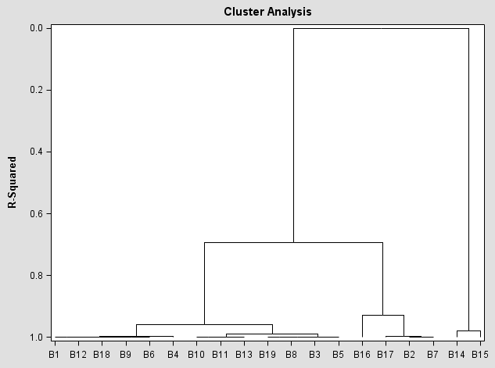
2. Preparing the Input Variables – Categorical Inputs
Preparing the Input Variables – 2. Categorical Variables
Output:
Greenacre’s method - Example Continued
Then use the CLUSTER procedure to cluster the levels of branch using Greenacre’s method and to create a high resolution dendrogram.
Sample Code:
ods output clusterhistory=work.cluster;
proc cluster data=work.level method=ward outtree=work.fortree
plots=(dendrogram(vertical height=rsq));
freq _freq_;
var prop;
id branch;
run;

Slide 10
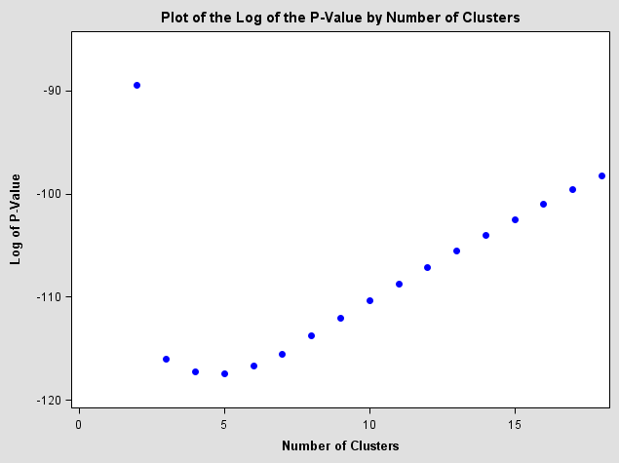
2. Preparing the Input Variables – Categorical Inputs
Preparing the Input Variables – 2. Categorical Variables
title1 "Plot of the Log of the P-Value by Number of Clusters";
proc sgplot data=work.cutoff;
scatter y=logpvalue x=numberofclusters
/ markerattrs=(color=blue symbol=circlefilled);
xaxis label="Number of Clusters";
yaxis label="Log of P-Value" min=-120 max=-85;
run;
Output:
Greenacre’s method - Example Continued
To calculate the optimum number of clusters, the chi-square statistic and the associated p-value needs to be computed for each collapsed contingency table.
Sample Code:
proc freq data=work.train_imputed noprint;
tables branch*ins / chisq;
output out=work.chi(keep=_pchi_) chisq;
run;
data work.cutoff;
if _n_=1 then set work.chi;
set work.cluster;
chisquare=_pchi_*rsquared;
degfree=numberofclusters-1;
logpvalue=logsdf('CHISQ',chisquare,degfree);
run;

Slide 11
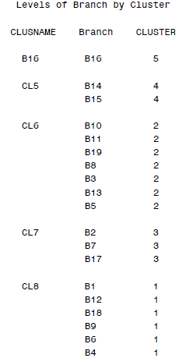
2. Preparing the Input Variables – Categorical Inputs
Preparing the Input Variables – 2. Categorical Variables
title1 "Levels of Branch by Cluster";
proc print data=work.clus;
by clusname;
id clusname;
run;
Output:
Greenacre’s method - Example Continued
The graph shows that the 5-cluster solution had the lowest p-value.
Sample Code:
proc sql;
select NumberOfClusters into :ncl
from work.cutoff
having logpvalue=min(logpvalue);
quit;
proc tree data=work.fortree nclusters=&ncl out=work.clus noprint;
id branch;
run;
proc sort data=work.clus;
by clusname;
run;

Slide 12
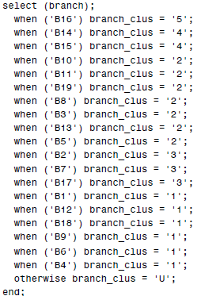
2. Preparing the Input Variables – Categorical Inputs
Preparing the Input Variables – 2. Categorical Variables
Greenacre’s method - Example Continued
Use a DATA step to write out the rules.
Sample Code:
filename brclus "&PMLRfolder\branch_clus.sas";
data _null_;
file brclus;
set work.clus end=last;
if _n_=1 then put "select (branch);";
put " when ('" branch +(-1) "') branch_clus = '" cluster +(-1) "';";
if last then do;
put " otherwise branch_clus = 'U';" / "end;";
end;
run;
data work.train_imputed_greenacre;
set work.train_imputed;
%include brclus / source2;
run;
Code generated by the DATA step:
End of Example

Slide 13

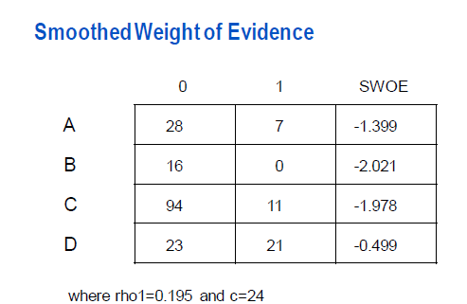
2. Preparing the Input Variables – Categorical Inputs
Preparing the Input Variables – 2. Categorical Variables
Smoothed Weight of Evidence (SWOE)
Another technique to deal with categorical inputs is to replace the levels with a single column that represents the event rate for each category.
Smoothed Weight of Evidence is a technique that averages the observed log(odds) of the event in a particular group with the log(odds) in the overall population.
where c is a smoothing parameter

Slide 14
2. Preparing the Input Variables – Categorical Inputs
Preparing the Input Variables – 2. Categorical Variables
Smoothed Weight of Evidence (SWOE) - Example
Computing Smoothed Weight of Evidence
Sample Code:
%global rho1;
proc sql noprint;
select mean(ins) into :rho1
from work.train_imputed;
run;
proc means data=work.train_imputed sum nway noprint;
class branch;
var ins;
output out=work.counts sum=events;
run;
filename brswoe "&PMLRfolder\swoe_branch.sas";
data _null_;
file brswoe;
set work.counts end=last;
logit=log((events + &rho1*24)/(_FREQ_ - events + (1-&rho1)*24));
if _n_=1 then put "select (branch);" ;
put " when ('" branch +(-1) "') branch_swoe = " logit ";" ;
if last then do;
logit=log(&rho1/(1-&rho1));
put " otherwise branch_swoe = " logit ";" / "end;";
end;
run;
data work.train_imputed_swoe;
set work.train_imputed;
%include brswoe / source2;
run;

Slide 15
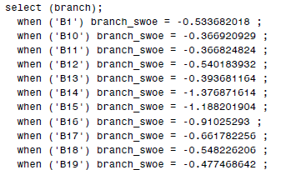
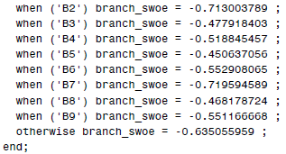
2. Preparing the Input Variables – Categorical Inputs
Preparing the Input Variables – 2. Categorical Variables
Smoothed Weight of Evidence (SWOE) - Example
A listing of the code generated is shown below.
End of Example

Slide 16
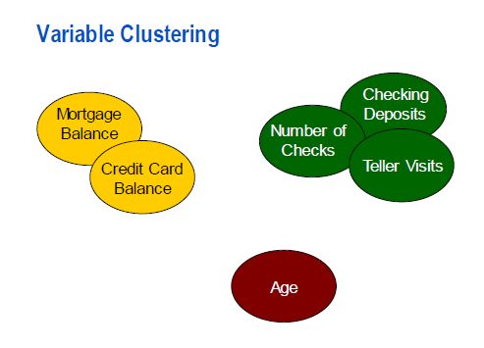
2. Preparing the Input Variables – Variable Clustering
Preparing the Input Variables – 3. Variable Clustering
Problem of redundant variables
destabilizing the parameter estimates
increasing the risk of overfitting (predictive modeling)
confounding interpretation
increasing computation time
increasing scoring effort
increasing the cost of data collection and augmentation
Variable Clustering

Slide 17
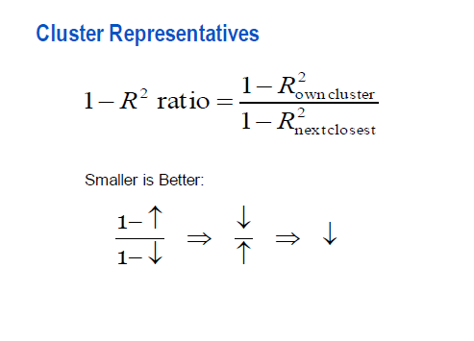
2. Preparing the Input Variables – Variable Clustering
Preparing the Input Variables – 3. Variable Clustering
Cluster Representatives
An ideal representative would have high correlation with its own cluster and have a low correlation with the other clusters.
Consequently, variables with the lowest 1-R² ratio (defined below) in each cluster would be good representatives.
Of course, subject-matter considerations might dictate the selection of other representatives.

Slide 18
2. Preparing the Input Variables – Variable Clustering
Preparing the Input Variables – 3. Variable Clustering
Variable Clustering using the VARCLUS procedure – Example
Cluster numeric variables in the data set. These include the original numeric inputs, the missing indicators, and the dummy variables for the collapsed branch.
Sample code:
ods select none;
ods output clusterquality=work.summary
rsquare=work.clusters;
proc varclus data=work.train_imputed_swoe hi;
var &num_inputs branch_swoe miacctag
miphone mipos miposamt miinv
miinvbal micc miccbal miccpurc
miincome mihmown milores mihmval
miage micrscor;
run;
ods select all;
%global nvar;
data _null_;
set work.summary;
call symput('nvar',compress(NumberOfClusters));
run;
title1 "Variables by Cluster";
proc print data=work.clusters noobs label split='*';
where NumberOfClusters=&nvar;
var Cluster Variable RSquareRatio VariableLabel;
label RSquareRatio="1 - RSquare*Ratio";
run;

Slide 19
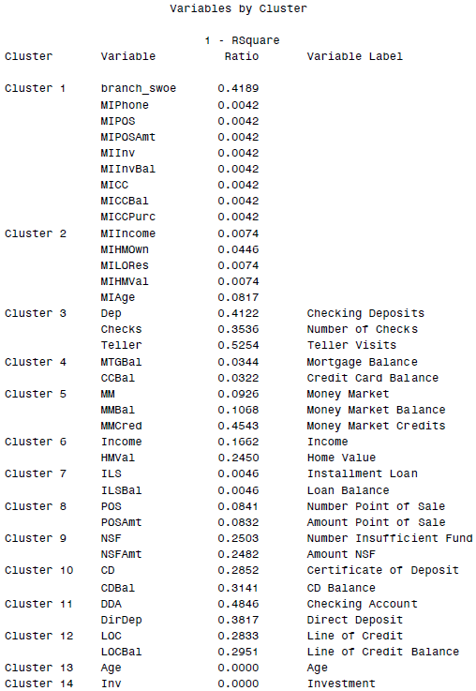
2. Preparing the Input Variables – Variable Clustering
Preparing the Input Variables – 3. Variable Clustering
Variable Clustering using the VARCLUS procedure – Example Continued
Partial output:

Slide 20
2. Preparing the Input Variables – Variable Clustering
Preparing the Input Variables – 3. Variable Clustering
Variable Clustering using the VARCLUS procedure – Example Continued
As mentioned, subject-matter considerations should play a part in deciding which inputs become the cluster representatives.
Consider the first cluster, which consists of variables branch_swoe, MIPhone, MIPOS, MIPOSAmt, MIInv, MIInvBal, MICC, MICCBal, and MICCPurc. According to the 1-R-Square ratio, any of the missing indicators would be the best cluster representative. However, closer investigation of the development data set might reveal that the missingness of those eight inputs has more to do with poor data quality than any other source of missing data. If these missing indicators in actuality indicate poor data quality, then their usefulness as predictors is suspect. With that subject-matter consideration in mind, perhaps branch_swoe is the best cluster representative from cluster 1.
Sample code:
%global reduced;
%let reduced=branch_swoe MIINCOME Dep CCBal MM Income ILS POS NSF CD
DDA LOC Age Inv InArea AcctAge Moved CRScore MICRScor
IRABal MIAcctAg SavBal CashBk DDABal SDB InvBal CCPurc
ATMAmt Sav CC Phone HMOwn DepAmt IRA MTG ATM LORes;
End of Example

Slide 21
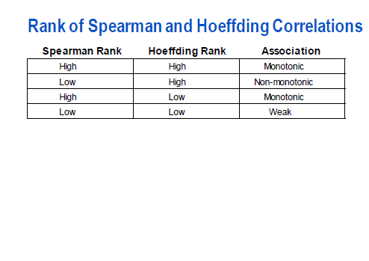
2. Preparing the Input Variables – Variable Screening
Preparing the Input Variables – 4. Variable Screening
Rank of Spearman and Hoeffding Correlations
One way to detect nonlinear relationships is to compare the ranks of the Spearman correlation statistic with the ranks of the Hoeffding’s D statistic.
An added benefit of comparing the ranks of the Spearman correlation statistics with the ranks of the Hoeffding’s D statistic is to eliminate clearly irrelevant variables.

Slide 22
2. Preparing the Input Variables – Variable Screening
Preparing the Input Variables – 3. Variable Clustering
Rank of Spearman and Hoeffding Correlations – Example
Sample code:
ods select none;
ods output spearmancorr=work.spearman
hoeffdingcorr=work.hoeffding;
proc corr data=work.train_imputed_swoe spearman hoeffding;
var ins;
with &reduced;
run;
ods select all;
proc sort data=work.spearman;
by variable;
run;
proc sort data=work.hoeffding;
by variable;
run;
data work.correlations;
merge work.spearman(rename=(ins=scorr pins=spvalue))
work.hoeffding(rename=(ins=hcorr pins=hpvalue));
by variable;
scorr_abs=abs(scorr);
hcorr_abs=abs(hcorr);
run;
proc rank data=work.correlations out=work.correlations1 descending;
var scorr_abs hcorr_abs;
ranks ranksp rankho;
run;

Slide 23
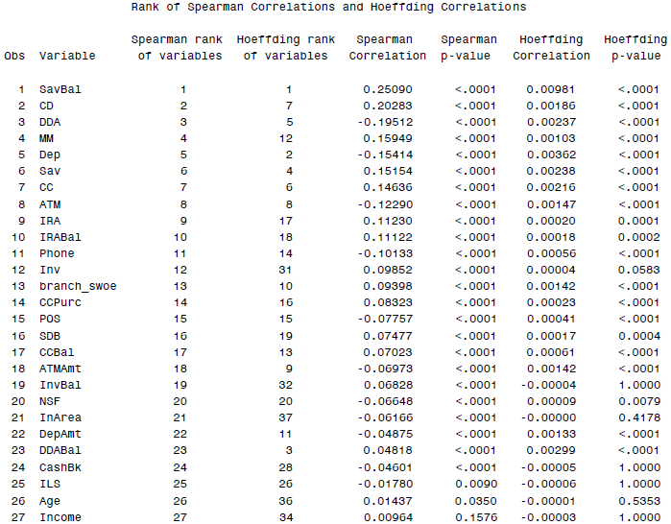
2. Preparing the Input Variables – Variable Screening
Preparing the Input Variables – 4. Variable Screening
Rank of Spearman and Hoeffding Correlations – Example Continued
Sample code:
proc sort data=work.correlations1;
by ranksp;
run;
title1 "Rank of Spearman Correlations and Hoeffding Correlations";
proc print data=work.correlations1 label split='*';
var variable ranksp rankho scorr spvalue hcorr hpvalue;
label ranksp ='Spearman rank*of variables'
scorr ='Spearman Correlation'
spvalue='Spearman p-value'
rankho ='Hoeffding rank*of variables'
hcorr ='Hoeffding Correlation'
hpvalue='Hoeffding p-value';
run;
Partial Output:

Slide 24
2. Preparing the Input Variables – Variable Screening
Preparing the Input Variables – 4. Variable Screening
Rank of Spearman and Hoeffding Correlations – Example Continued
A graphical representation of this table would aid decision making.
Sample code:
%global vref href;
proc sql noprint;
select min(ranksp) into :vref
from (select ranksp
from work.correlations1
having spvalue > .5);
select min(rankho) into :href
from (select rankho
from work.correlations1
having hpvalue > .5);
quit;
title1 "Scatter Plot of the Ranks of Spearman vs. Hoeffding";
proc sgplot data=work.correlations1;
refline &vref / axis=y;
refline &href / axis=x;
scatter y=ranksp x=rankho / datalabel=variable;
yaxis label="Rank of Spearman";
xaxis label="Rank of Hoeffding";
run;

Slide 25
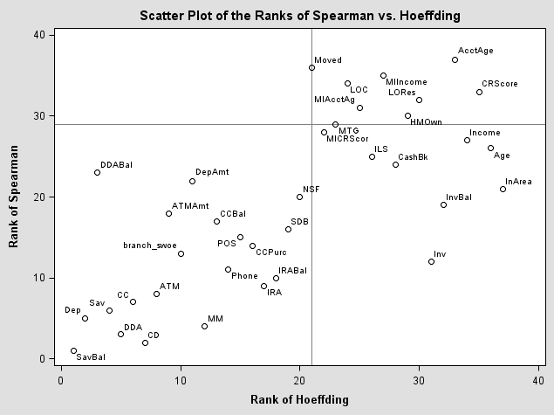
2. Preparing the Input Variables – Variable Screening
Preparing the Input Variables – 4. Variable Screening
Rank of Spearman and Hoeffding Correlations – Example Continued
Output:
In general, the upper right corner of the plot contains the names of variables that could reasonably be excluded from further analysis,
due to their poor rank on both metrics.
Low ranks of Spearman and high ranks for
Hoeffding’s D suggest non-monotonic relationship
with target, and some other type of relationship
is detected by Hoeffding’s D statistic. Empirical
logit plots should be used to examine further.
Sample code:
%global screened;
%let screened=SavBal Dep DDA CD Sav CC ATM MM branch_swoe Phone IRA IRABal
DDABal ATMAmt ILS POS NSF CCPurc SDB DepAmt CCBal Inv InArea
Age CashBk MICRScor Income InvBal;
End of Example

Slide 26
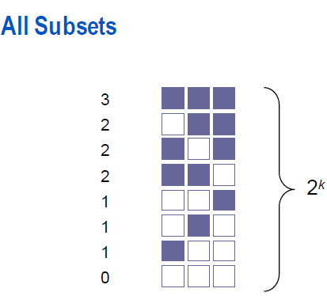
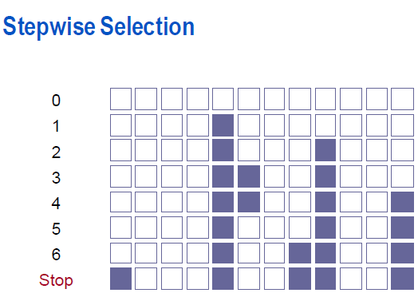
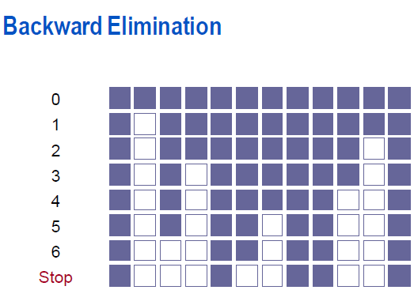
2. Preparing the Input Variables – Subset Selection
Preparing the Input Variables – 5. Subset Selection
Subset Selection Methods
Stepwise selection was devised to give a computationally efficient alternative to examining all subsets. It is not guaranteed to find the best subset and it can be shown to perform badly in many situations (Harrell 1997).
Backward elimination is less inclined to exclude important inputs or include spurious inputs than forward (stepwise) methods (Mantel 1970; Harrell 1997). However, it is considered more computationally expensive than stepwise because more steps are usually required and they involve larger models.

Slide 27
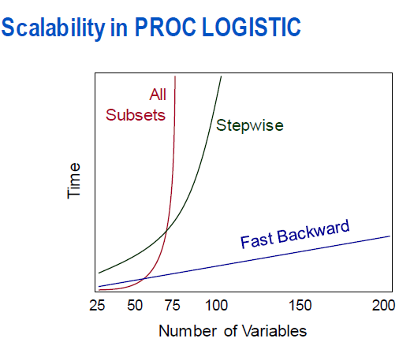
2. Preparing the Input Variables – Subset Selection
Preparing the Input Variables – 5. Subset Selection
Computation Time
Linear regression
stepwise < backward < all subsets.
Logistic regression (as implemented by PROC LOGISTIC). For up to ≈60 inputs
all subsets < fast backward < stepwise
Logistic regression (as implemented by PROC LOGISTIC). For ≈ 60 up to ≈200 inputs
fast backward < stepwise < all subsets

Slide 28
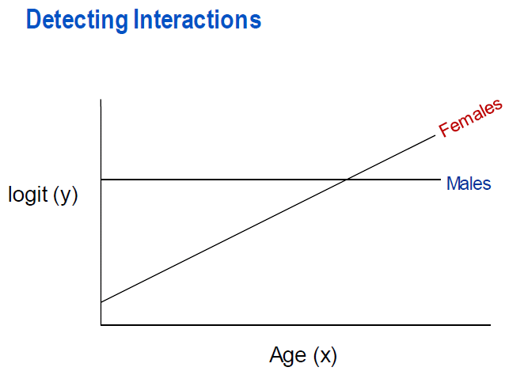
2. Preparing the Input Variables – Subset Selection
Preparing the Input Variables – 5. Subset Selection
Detecting Interactions
Interaction occurs when the relationship between an input variable and the target differs by the level of another input variable.

Slide 29
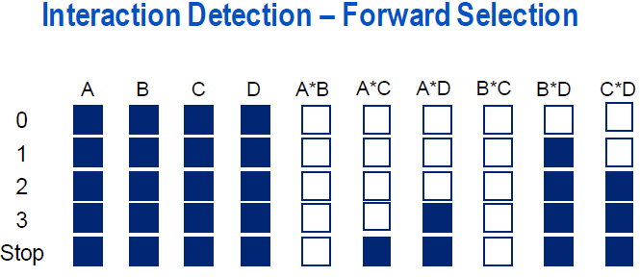
2. Preparing the Input Variables – Subset Selection
Preparing the Input Variables – 5. Subset Selection
Detecting Interactions
The forward selection method might be useful in detecting interactions.
Start with the main effects only model and then let the forward selection method search for and significant interactions.
The significance level should be relatively low because you only want to include relatively strong interactions I final model.

Slide 30
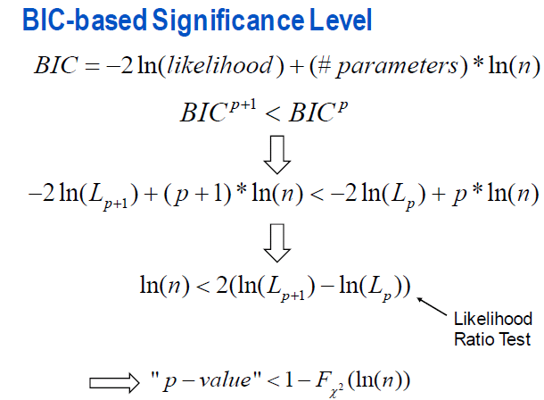
2. Preparing the Input Variables – Subset Selection
Preparing the Input Variables – 5. Subset Selection
BIC-based Significance Level

Slide 31

2. Preparing the Input Variables – Subset Selection
Preparing the Input Variables – 5. Subset Selection
Interaction Detection – Example
Compute a BIC-based significance level using the sample size for n. Then use the forward selection method to detect important 2 factor interactions.
Sample code:
title1 "P-Value for Entry and Retention";
%global sl;
proc sql;
select 1-probchi(log(sum(ins ge 0)),1) into :sl
from work.train_imputed_swoe_bins;
quit;
Output:
The significance level is much lower than the common 0.05 level.

Slide 32
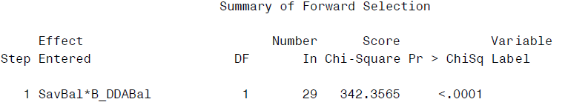
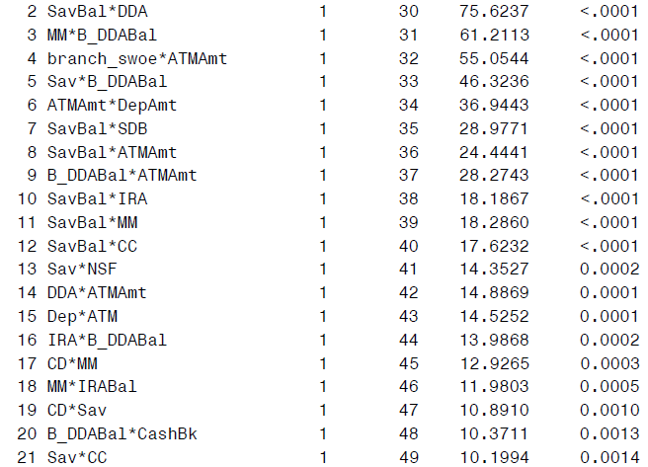
2. Preparing the Input Variables – Subset Selection
Preparing the Input Variables – 5. Subset Selection
Interaction Detection – Example Continued
Sample code:
title1 "Interaction Detection using Forward Selection";
proc logistic data=work.train_imputed_swoe_bins;
class res (param=ref ref='S');
model ins(event='1')= &screened res
SavBal|Dep|DDA|CD|Sav|CC|ATM|MM|branch_swoe|Phone|IRA| IRABal|B_DDABal|ATMAmt|ILS|POS|NSF|CCPurc|SDB|DepAmt| CCBal|Inv|InArea|Age|CashBk|MICRScor|Income|res @2 / include=28 clodds=pl
selection=forward slentry=&sl;
run;
Partial Output:
Twenty-one interactions were selected using the BIC-based significance level.

Slide 33
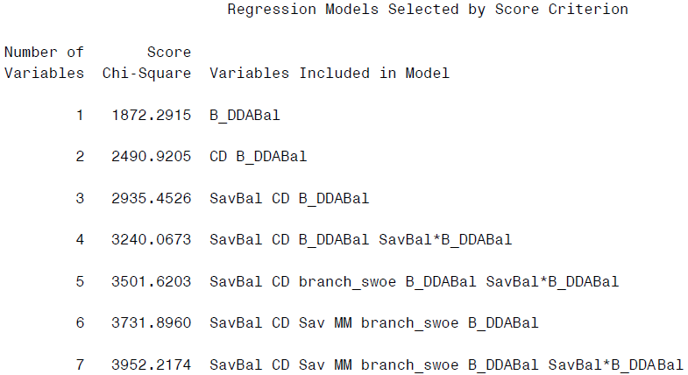
2. Preparing the Input Variables – Subset Selection
Preparing the Input Variables – 5. Subset Selection
Automatic Subset Selection – Example
Use the best subsets selection method to find a subset of inputs. Because the best subsets method does not support class variables, create dummy variables for Res.
Sample code:
data work.train_imputed_swoe_bins;
set work.train_imputed_swoe_bins;
resr=(res='R');
resu=(res='U');
run;
title1 "Models Selected by Best Subsets Selection";
proc logistic data=work.train_imputed_swoe_bins;
model ins(event=‘1’)=&screened resr resu SavBal*B_DDABal MM*B_DDABal branch_swoe*ATMAmt B_DDABal*Sav SavBal*SDB SavBal*DDA ATMAmt*DepAmt B_DDABal*ATMAmt SavBal*ATMAmt SavBal*IRA SavBal*MM SavBal*CC Sav*NSF DDA*ATMAmt Dep*ATM IRA*B_DDABal CD*MM MM*IRABal CD*Sav B_DDABal*CashBk Sav*CC / selection=score best=1;
run;
Partial Output:
The model with the best fit to the data is not readily apparent. The score test statistic should not be used since it increases with model size.
When the SELECTION=SCORE option is used, output data sets are not available. However, the Output Delivery System can be used to create an output data set with the variables selected.

Slide 34
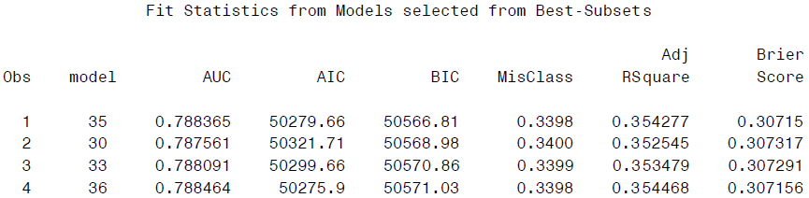
2. Preparing the Input Variables – Subset Selection
Preparing the Input Variables – 5. Subset Selection
Automatic Subset Selection – Example Continued
Use the fitstat macro to generate fit statistics for the models generated by the best subsets selection.
Sample code:
%fitstat(data=train_imputed_swoe_bins,target=ins,event=1,inputs=&screened resr resu SavBal*B_DDABal MM*B_DDABal branch_swoe*ATMAmt B_DDABal*Sav SavBal*SDB SavBal*DDA ATMAmt*DepAmt B_DDABal*ATMAmt SavBal*ATMAmt SavBal*IRA SavBal*MM SavBal*CC Sav*NSF DDA*ATMAmt Dep*ATM IRA*B_DDABal CD*MM MM*IRABal CD*Sav B_DDABal*CashBk Sav*CC,best=1,priorevent=0.02);
proc sort data=work.modelfit;
by bic;
run;
title1 "Fit Statistics from Models selected from Best-Subsets";
proc print data=work.modelfit;
var model auc aic bic misclass adjrsquare brierscore;
run;
Partial Output:
The results reveal that the 35-input
model has the smallest value of bic.

Slide 35
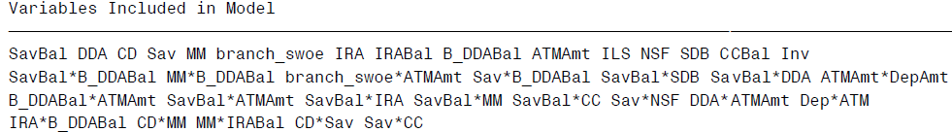
2. Preparing the Input Variables – Subset Selection
Preparing the Input Variables – 5. Subset Selection
Automatic Subset Selection – Example Continued
Create a macro variable selected that contains the names of the inputs in that model.
Sample code:
%global selected;
proc sql;
select VariablesInModel into :selected
from work.score
where numberofvariables=35;
quit;
Output:
The model with the lowest BIC is not hierarchically well formulated (DepAmt, Dep, ATM, and CC would have to be added).
End of Example

Slide 36
2. Preparing the Input Variables – Subset Selection
Recap
Explore the Data
Prepare the Input Variables
Missing Values
Create missing value indicator
Categorical Inputs
Thresholding
Greenacre’s method
Smoothed Weight of Evidence (SWOE)
Variable Clustering (PROC VARCLUS, 1-R² ratio)
Variable Screening
Rank of Spearman and Hoeffding Correlations
Subset Selection
Methods: all subsets, stepwise/forward, backward
Interaction detection: BIC-based significance level
Automatic subset selection: best subset selection, fitstat macro

Slide 37
Appendix

Slide 38
Appendix
Macro fitstat
%macro fitstat(data=,target=,event=,inputs=,best=,priorevent=);
ods select none;
ods output bestsubsets=work.score;
proc logistic data=&data namelen=50;
model &target(event="&event")=&inputs / selection=score best=&best;
run;
/* The names and number of variables are transferred to macro variables using PROC SQL. */
proc sql noprint;
select variablesinmodel into :inputs1 -
from work.score;
select NumberOfVariables into :ic1 -
from work.score;
quit;
%let lastindx=&SQLOBS;
%do model_indx=1 %to &lastindx;
%let im=&&inputs&model_indx;
%let ic=&&ic&model_indx;
ods output scorefitstat=work.stat&ic;

Slide 39
Appendix
/* The data sets with the model fit statistics are
concatenated and sorted by BIC. */
data work.modelfit;
set work.stat1 - work.stat&lastindx;
model=_n_;
run;
%mend fitstat;
proc logistic data=&data namelen=50;
model &target(event="&event")=&im;
score data=&data out=work.scored fitstat
priorevent=&priorevent;
run;
proc datasets
library=work
nodetails
nolist;
delete scored;
run;
quit;
%end;

